Slide 1

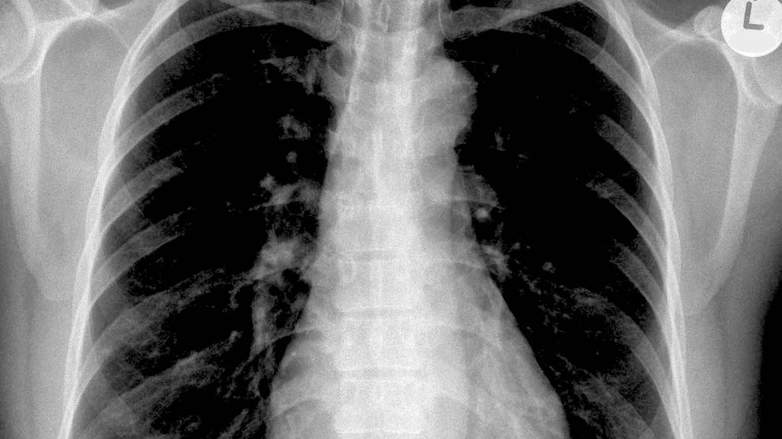
Lung cancer detection model
Detect Early. Breathe Freely. Empowering Lives with Every Scan
This Photo by Unknown Author is licensed under CC BY-SA-NC

Slide 2

Defining the problem
Lung cancer remains one of the most fatal diseases worldwide, with high mortality rates due to late-stage diagnosis. Traditional diagnosis using radiologists is time-consuming and may vary based on expertise. There is a growing need for a fast, reliable, and interpretable method to automatically detect lung cancer at early stages from chest X-ray images.
This model will assist radiologists and doctors in faster diagnosis and early treatment planning, potentially saving lives through early intervention.

Slide 3
Data collection
Public datasets such as Kaggle, CheXpert, or LIDC-IDRI.
Manual selection of X-ray images into two folders:
lung_cancer_data/cancer/
lung_cancer_data/normal/
Test Set: Images placed in
Offline sources for dataset/images from different surgeons and Medical colleges

Slide 4
Data Cleaning
:
Remove Corrupted or Invalid Images:- Some images might be unreadable or broken.
Convert all X-Ray images into .jpg or .png but should be in same format.
Resizing all images according to the project
Balance the Dataset (Optional but Helpful):- If cancer/normal images are unequal, balance using:
Undersampling: remove extra images from the larger class.
Oversampling: augment or duplicate images from the smaller class.
Or use weighted loss function during training.

Slide 5
Exploratory Data Analysis (EDA)
Count images in each class to check for imbalance.
1
Visualize sample cancerous and normal images.
2
Check image quality, pixel intensity distributions.
3
Analyze which type of cancer it is based on location of cancerous region in the lungs.
4

Slide 6
Model building/Modelling the data
Model Used: Custom CNN (Convolutional Neural Network) using PyTorch.
Architecture:
2 convolutional layers
Fully connected layers
Output: Binary classification (Cancer / Normal)

Slide 7
Model evaluation and training
Metrics Used:AccuracyConfusion MatrixPrecision, Recall, F1-scoreResult
Example:Training accuracy: 99%Test accuracy: 94%Check misclassified images
Split Data: 80% training, 20% testing
Loss Function: CrossEntropyLoss
Optimizer: Adam
Device: GPU (if available)
Epochs: Typically 10–20
Output:
Trained model saved as lung_model.pth
Logs of training loss per epoch

Slide 8
Model Deployment & Prediction
Script: Detect.py
Usage:Takes images from test_images/
Loads trained model (lung_model.pth)Predicts whether each image is cancerous or normalSaves
Grad-CAM heatmaps for cancer predictionsPrints reason for each prediction based on heatmap.
Grad-CAM Purpose: Show where the model is focusing in the image.
Visual Output : Overlays red/yellow heatmap on regions indicating cancerText
Output : Gives reason like: "High density region detected in upper-left lobe, suggesting potential malignancy."

Slide 9
Future enhancements
Make it more efficient using other scanning tests.
Giving pre-cautionary steps based on your lung condition
Authorizing a doctor/medical advisor with the model.

Slide 10
Conclusion
The deep learning model can:
Detect cancer in X-rays with high accuracy.
Show affected areas visually (Grad-CAM).
Give interpretable output (reasoning).
Limitations:
Accuracy depends on data quality.
Not a replacement for real doctors—just an assistive tool.(Kind of a pro)

